Slide 1
IMAGIN-e Track: Final submission [Name of your solution]
[Name of your team]
September 2023

Slide 2

Final submissions
Each valid submission must consist of:
The functional prototype
A link to a notebook or the notebook (.ipynb) itself with your software solution. Include any relevant information needed to run the notebook.
A pdf version of the notebook with any outputs displayed.
The pitch of your solution
A video pitch of a maximum of 3 minutes
Presentation of your solution
A PowerPoint presentation (saved as a .pdf file) detailing your idea and its implementation.
Judging Criteria
25% Suitability of the solutions for solving societal and/or business challenges
25% Level of creativity & originality
25% Technical and programmatic feasibility of the implementation
25% Contribution to Open Science

Slide 3
Show us your functional prototype
Please provide a link of your notebook.
Please insert the link to your notebook (.ipynb) here…
Please insert the link to your notebook in .pdf version here…

Slide 4
Pitch your solution
Please provide us with the link to your video pitch. For guidance on what you pitch should contain please check this link.
The video can be uploaded to any online platform such as YouTube, Vimeo, etc. The video does not have to be public; you can publish it as unlisted or private.
Please do a test before to make sure that the video can be viewed by anyone with the link.
Please insert the link here…

Slide 5
Guidelines to complete this document
Below are a set of instructions so you will know how to submit this document as final submission and enter in the race of being one of the 10 teams that can have their solution launched into space. Entries that do not comply with these instructions will not be accepted. Please read carefully!
This file must be submitted by
Complete this entire template using a font no larger than:
26-point size in the Calibri font for the body of the slides;
35-point size in the Calibri font for the title of the slides;
Please do not change this document’s format
It is encouraged to add images, arrange text boxes in a logical order or add shapes, icons, smart art, charts etc. to make your argumentation more descriptive and compelling
Your completed document must not be more than 17 slides (including the explanation ones). Answer the questions in the title box of each slide from the Solution Presentation. The questions precisely highlight the information that the reviewer must check, so it is in your interest to organise your document and present the right information on the right slide
Save this file as a .pdf document and in the filename replace “IMAGIN-e Track_Final Submission Template" with “IMAGIN-e_FS_[Team Name]“. Please do not add any other annotations such as v1, DDMMYYYY, etc.
To submit: Depending on the chosen track you must complete this document and make a submission with the file as a .pdf to one of the following URLs:
Φsat-2 Track: https://platform.ai4eo.eu/orbitalai-phisat-2
IMAGIN-e Track: https://platform.ai4eo.eu/orbitalai-imagin-e
20 Sep 2023, 17:00 CEST.

Slide 6
Name of your team/solution
Date:

Slide 7
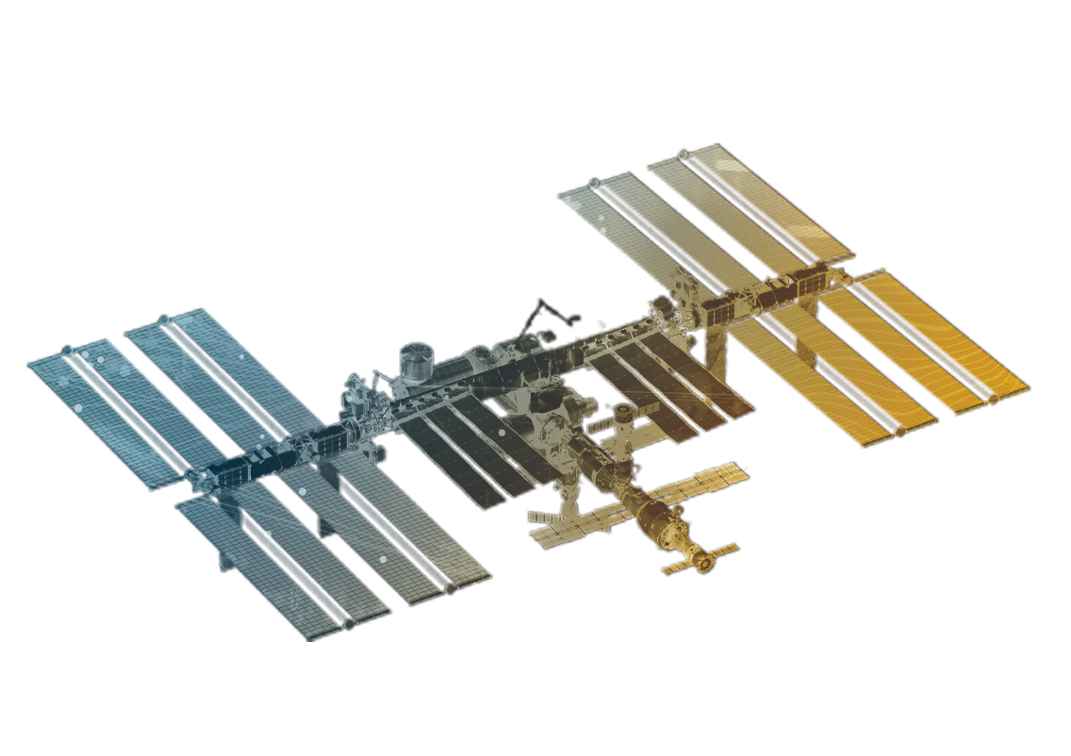
Value proposition – 2 slides
Start by writing your idea in one paragraph.
Then, expand on what’s the value that your solution brings to Earth from a social, economic, and environmental perspective.
Finalise by telling us what are the methods/algorithms/technologies used in your solution.

Slide 8
Value proposition
You have two slides for the value proposition. This is the continuation of the previous question.

Slide 9
Technical aspects – 1 slide
Time to get technical – Tell us more about the way in which you are utilising AI technology.
What is new and innovative about your solution?
How does your solution add value to existing state of technology?

Slide 10
What is the architecture of your AI model? – 1 slide

Slide 11
Technical feasibility and scientifically correctness – 2 Slides
Demonstrate that your solution is technically feasible scientifical correct and if it is a priori compatible with the IMAGIN-e mission (technical and programmatic level).
Please check the scientific notice of the mission here.

Slide 12
Technical feasibility and scientifically correctness
You have two slides for technical feasibility and scientific correctness. This is the continuation of the previous question.

Slide 13
Validation of the model – 2 slide
Can you please talk about the performance of your model in terms of:
Accuracy - Clearly state the evaluation metrics used to assess the performance of your model. This may include accuracy, precision or any other relevant metrics depending on the problem domain.
Size - Mention the size or complexity of your AI model. This could include the number of parameters, layers, or any other relevant measure of model size.
Test database - Discuss the representativity of the test database used for evaluation. Consider whether the test data covers a wide range of scenarios, captures diverse examples, and is reflective of real-world conditions.

Slide 14
Validation of the model
You have two slides for the validation of your model. This is the continuation of the previous question.

Slide 15
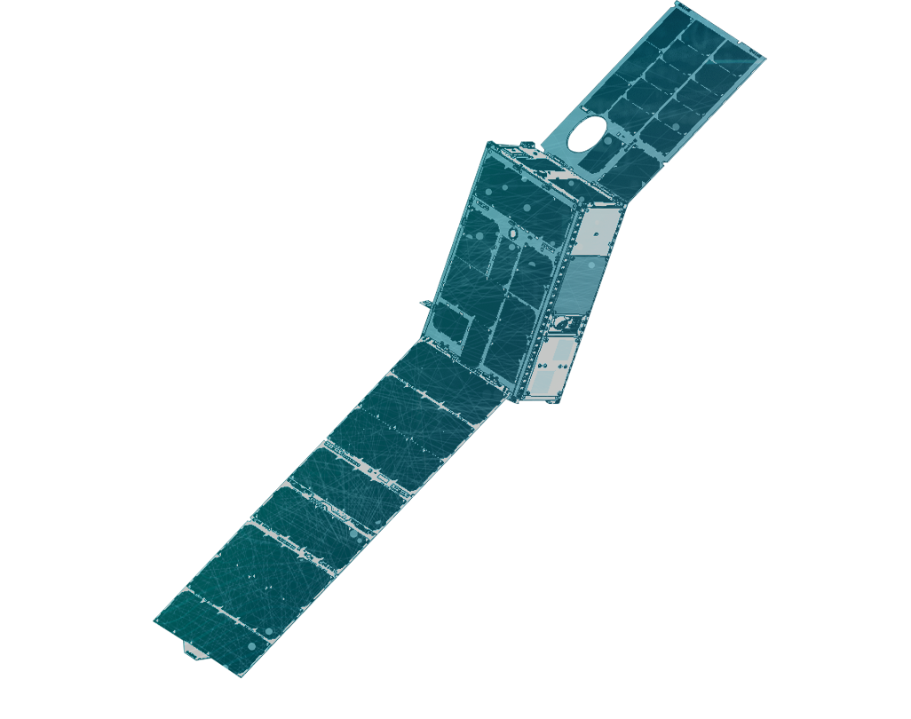
Contribution to open science – 1 slide
Keep it short but concise!
Tell us more about the level of applicability to the wider community you hope to achieve.
Give us an insight into the level of detail of your methodology.

Slide 16
Team – 1 slide
Present your team members, their expertise and why your team composition is optimal to ensure the credibility and potential implementation of your solution.

Slide 17
Extra slide – 1 slide
In this slide you can add other information that was not covered by the previous questions, but you consider it important to mention.

